Slide 1
Testing with JUnit and Mockito

Slide 2
Basics of Testing
Testing is a very broad term that encompasses many different strategies, levels and techniques.
Software testing can be done either:
Manually (by a human using the system)
automated by writing tests with code.
Generally, when we discuss software testing, we are referring to this approach.
You’ve probably already performed manual testing by simply running your application code, providing some user input, and manually observing the resulting behavior.
This kind of testing is effective but does not scale well as the size of an application increases to 100, 1000s or tens of thousands of lines of code.

Slide 3
Basics of Testing (cont…)
Any time you develop software, testing should be considered as a crucial component to your development process.
Testing should not be:
Optional
An afterthought
A chore
Time-consuming
Strictly about ‘code coverage’
When creating and executing tests you should make sure that you:
Clarify the unambiguously state the requirements of the system
Ensure software meets expectations and helps achieve business objectives
Can easily identify areas that do not meet requirements
Quickly and easily make changes to the application and tests if needed
Assume product quality.

Slide 4
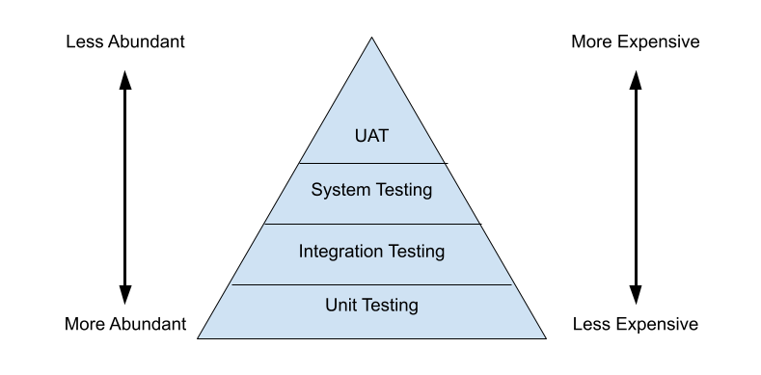
Testing Pyramid
When determining costs for tests, it is useful to keep the ‘Testing Pyramid’ in mind.
This is a visual representation of the cost vs abundance of tests based on certain “levels” of testing.
More tests exist at lower levels of the pyramid, than the top, because they exist at a lower level of abstraction.

Slide 5
Testing “Levels”
Unit Testing
Most Micro-level of testing
Test each component in isolation (without dependencies)
Usually requires mocking data
Unit testing tools include JUnit and TestNg
Integration Testing
Test components with dependencies
Check that components work with one another correctly
Logically related modules are tested as a group
Integration testing tools include selenium and protractor
System Testing
Test the entire application as a whole
Ensure the entire application works without errors
User Acceptance Testing (UAT)
Test that all requirements are met
Simulate an end-user to guarantee that users can perform all the tasks required
Generally, UAT is handled by a physical user
Two forms of UAT exist: Alpha and Beta
Alpha Testing – First round of UAT (normally in-house builds and teams)
Beta testing – Generally, testing done ‘out-of-house’

Slide 6
Unit Testing
Unit Testing is the testing of individual software components in isolation from the rest of a system.
This is done by writing tests which execute the code on the individual units we want to inspect.
When the code under scrutiny deviates from an expected outcome or behavior, the test will fail.
If the test passes, this means that application performs as expected (unless there is a problem with the test itself).
Unit testing should never manipulate actual databases or use real data. It is the process of testing the functionality, without changing the actual environment.
In Java the most common unit testing framework is called Junit (testNG is also very popular).

Slide 7
Unit Testing
New Code
Once a developer add more code, they need to write unit tests for the new code to ensure it is working properly
Alternatively, Tests can be written first if utilizing Test Driven Development
Refactoring
As projects grow and requirements change, code made need to be updated
Refactoring involves updating code on a later date and testing to make sure everything is still running smoothly, or quickly find what causes tests to fail.
What is a Test Case?
A test case is a set of conditions or variables under which a tester will determine whether an application is working correctly
Once we break up our code into a unit, we can come up with test cases that will determine if the unit is working correctly.

Slide 8
JUnit
JUnit is an open-source java framework designed for the purpose of writing and running unit testing.
JUnit allows for the creation of both application code and test during development.
JUnit also provides a graphical user interface (GUI) which makes it possible to write and test source code quickly and easily.
JUnit shows test progress in a bar that starts green if testing is going fine, but turns red when a test fails.

Slide 9
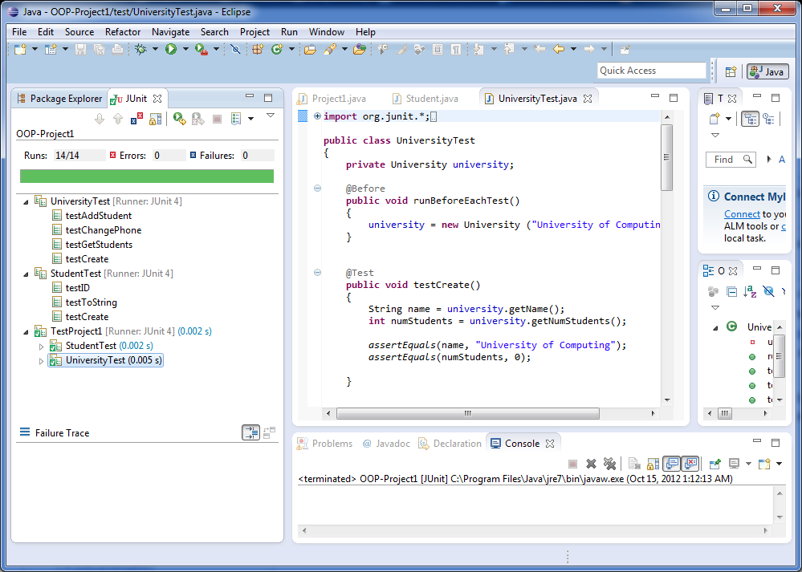
Junit Interface

Slide 10
JUnit Annotations
JUnit uses several annotations within the org.junit package that developers can use to create tests and setup test environments:
@Test – declares a method as a test method
@BeforeClass – declares a setup method that runs once, before all other methods in the class
@Before – declares a setup method that runs before each test method is run
@After – declares a ‘tear-down’ method that runs after each test method
@AfterClass – declares a ‘tear-down’ method that runs once, after all other methods in the class
@Ignore – declares that the proceeding test will not be run.
Used to check other test cases within a test class before refactoring individual test cases.

Slide 11
JUnit Assertions
assertEquals() – Test to see if a return value is the same as an expected result
assertNotEquals() – Test to see if return value differs from an expected result
assertNull() – Test to see if an object/variable/etc… reference is null
assertNotNull() – Test to see if an object/variable/etc… has a non-null reference
assertArrayEquals() – Test to see if the values of an array match a provided array.
assertTrue() – Test to see if something is true
assertFalse() – Test to see if something is false

Slide 12
Static Imports
Normally, when you import code into a class file, you will specify the package and class name for which you want to import, or use a wildcard indicate (*) to specify all classes from a package:
import java.util.ArrayList;
import java.sql.*
However, when you declare a static method in a class, it is possible to include the static keyword in the import and refer to the single method in question. You can then reference the method as if it were written in the same class.
public class Example {
public static void doSomething() { … }
}
// Another class:
import static com.example.Example.doSomething;
public class Simulator {
public static void main(String[] args) {
doSomething();
}
}

Slide 13
Test Stubs
A test stub is a piece of code or a program that simulates the behavior of a portion of software that is under test.
Although a stub simulates behavior, the end goal is not to verify that behavior, but instead to verify state as part of the testing process.
Generally, a stub provides a predetermined answer or response rather than recreating the behavior it is replacing.

Slide 14
Mocking Data
A test mock is an object that mimics the behavior of a real object.
The primary goal of using a test mock is to verify the behavior of an object under test.
This approach to testing is also called Behavior Verification.
Tools such as Mockito give developers the ability to easily mock classes.
Test mocks are used to inject behavior where needed and verify the behavior of the code.

Slide 15
Mocks vs Stubs
// TEST STUBS:
public class Example {
public int sum(int... nums) {
int sum = 0;
for (int i : nums) {
sum += i;
}
return sum;
}
}
//Equivalent method stub:
public int sum() {
return 1;
}
// TEST MOCKS:
public class Example {
public int sum(int... nums) {
int sum = 0;
for (int i : nums) {
sum += i;
}
return sum;
}
}
//test mock:
public int ExampleMock extends Example {
// Override inherited methods here!
}

Slide 16
Mockito
Mockito is a mocking framework for unit tests in java that provides support for test stubs and test mocks.
It provides a simple API which allows for readable tests and simple verification errors.
Due to its simplicity, it is one of the most popular mocking libraries for Java.
Mockito eliminates the need to manually mock objects. All the developer has to do is specify the type they would like to mock and Mockito will create the requested mocks at runtime.
Mockito uses built-in annotations which make it easy to learn and use. Ex: @Mock
Provides simple behavior verification. For instance, keeping track of the number of times a method is called uses Mockito’s Verify() method.
Other mocking frameworks include: EasyMock, and JMockit.

Slide 17
Mockito Features
Mockito utilizes a simple annotation system for easy mocking:
@Mock – Annotation used to create mock classes
@InjectMocks – Annotation used to inject mocked classes into another class
initMocks() – Method used to initialize the mocked classes. For Mockito 4 and lower, this method must be invoked before mocks can be used.
Method Stubbing:
when() – The when method allows you to return canned/dummy results. This ensures that internal systems are preserved during unit testing.
Behavior Verification
verify() – Allows for the verification that code has been invoked correctly.

Slide 18
Test Driven Development
When developing software, it is important to ensure that most, if not all, of the code being written is tested to verify the functionality of the code.
One way to ensure this, is to follow a process called ‘test-driven development’ or TDD.
The TDD process consists of writing unit tests first, before the application code has been written. Then, code can be written to make the test pass, and the process can be completed for each piece of functionality required.

Slide 19
TDD Process
To follow a TDD process you would:
Write a unit test
Run the test => the test will fail
Fix the text by writing application code
Retest the code.
If the code fails: refactor the application code and test again
If the code does not fail: Repeat for the next test
Following the TDD process can be useful to ensure that a valid unit test always exists for any class or method that is written.
Later, when refactoring code, the unit tests give us confidence that we can change the source code without breaking functionality.
If we mess up somewhere, when the unit tests are run, we can pinpoint exactly where the problem lies.
This makes debugging much easier.

